Slide 1
SOLID Principles
Design Principles and Approaches
S
Single Responsibility
O
Open/Closed
L
Liskov substitution
I
Interface Segregation
D
Dependency Inversion
SoftUni Team
Technical Trainers
Software University
https://softuni.bg

Slide 2
Table of Contents
Single Responsibility
Open/Closed
Liskov Substitution
Interface Segregation
Dependency Inversion

Slide 3
Questions
sli.do #csharp-advanced

Slide 4
Why Clean Code Matters?
How clean code (or its absence) affects our software?
"...So if you want to go fast,
if you want to get done quickly,
if you want your code to be easy to write,
make it easy to read."
- Robert C. Martin

Slide 5

Single Responsibility

Slide 6
What is Single Responsibility?
Every class should be responsible for only a single part of the functionality and that responsibility should be entirely encapsulated by the class.
"There should never be more than one reason for a class to change."
- Robert C. "Uncle Bob" Martin
6

Slide 7

Strong Cohesion
Cohesion refers to the grouping of functionally related processes into a particular module.
Aim for strong cohesion
Each task maps a single code unit
A method should do one operation
A class should represent one entity
Notes:
Cohesion
Low: The convenience store. You go there for everything from gas to milk to ATM banking. Products and services have little in common, and the convenience of having them all in one place may not be enough to offset the resulting increase in cost and decrease in quality.
High: The cheese store. They sell cheese. Nothing else. Can't beat 'em when it comes to cheese though.
More inner instance variables - harder cohesion
Coupling
Loose: You and the guy at the convenience store. You communicate through a well-defined protocol to achieve your respective goals - you pay money, he lets you walk out with the bag of Cheetos. Either one of you can be replaced without disrupting the system.
Tight: You and your wife.

Slide 8
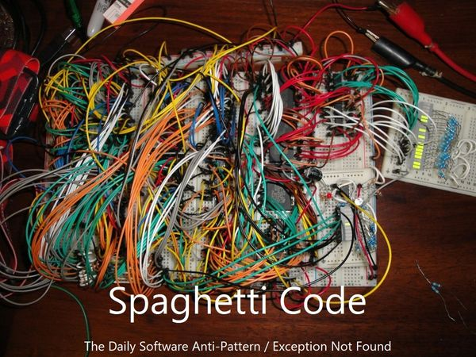
Loose Coupling
Coupling - the degree of dependence between modules
How closely connected two modules are
The strength of the relationship between modules
Aim for loose coupling
Supports readability and maintainability
Often a sign of good system design
Notes:
Cohesion
Low: The convenience store. You go there for everything from gas to milk to ATM banking. Products and services have little in common, and the convenience of having them all in one place may not be enough to offset the resulting increase in cost and decrease in quality.
High: The cheese store. They sell cheese. Nothing else. Can't beat 'em when it comes to cheese though.
More inner instance variables - harder cohesion
Coupling
Loose: You and the guy at the convenience store. You communicate through a well-defined protocol to achieve your respective goals - you pay money, he lets you walk out with the bag of Cheetos. Either one of you can be replaced without disrupting the system.
Tight: You and your wife.

Slide 9
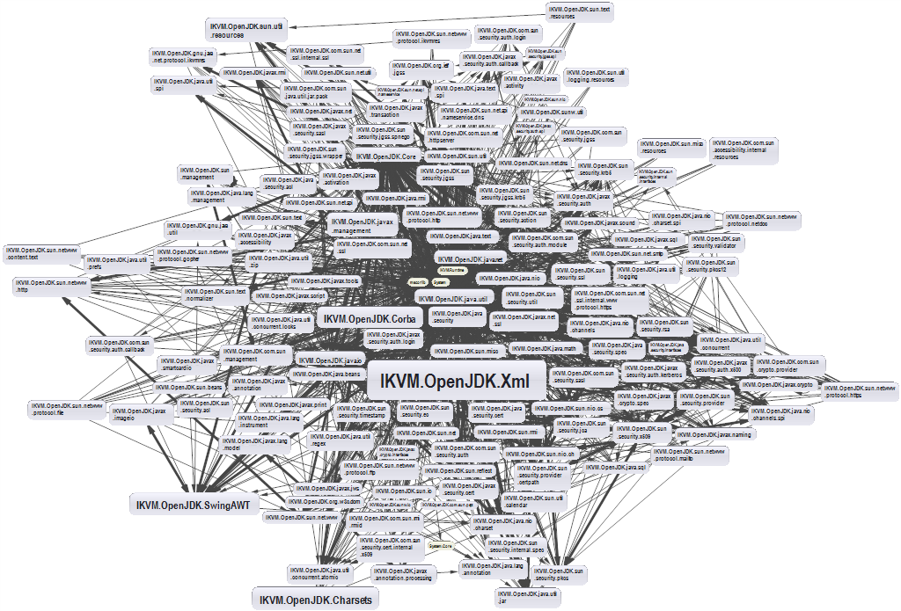
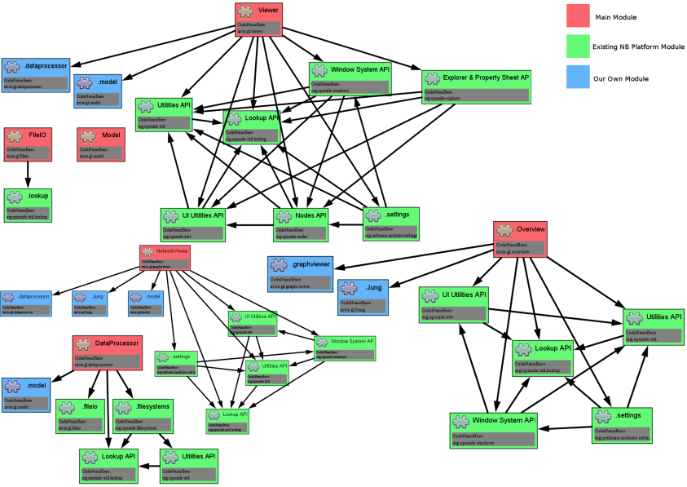
Dependencies and Coupling
Depend directly on other modules
Depend on abstractions
9

Slide 10
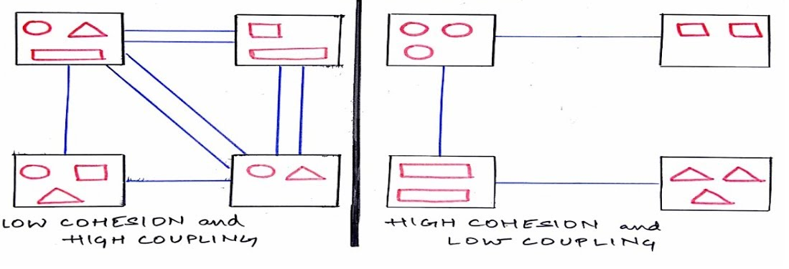
Cohesion and Coupling – Approaches
Small number of instance variables inside a class
Each method of a class should manipulate one or more of those variables
Two modules should exchange as little information as possible
Use abstraction
Creating an easily reusable subsystem

Slide 11


Open/Closed

Slide 12
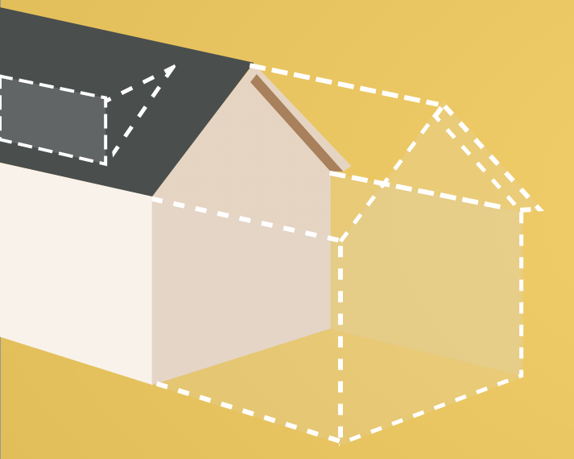
What is the Open/Closed Principle?
Software entities like classes, modules and functions should be open for extension, but closed for modifications
Extensibility
Adding a new behavior doesn’t require changes over existing source code
Reusability
subsystems are suitable for reusing in other projects - modularity

Slide 13
OCP – Approaches
Parameters
Control behavior specifics via a parameter or a delegate
Rely on abstraction, not implementation
Inheritance / Template Method Pattern
Strategy Pattern
Plug in model (insert a new implementation of the interface)
Notes:
When we use abstraction there is no limit in implementation

Slide 14
OCP – When to Apply
By experience - know the problem domain and if a change is very likely to recur
New domain problem - implement the most simple way
Changes once - modify, second time - refactor
TANSTAAFL - There Ain’t No Such Thing As A Free Lunch
OCP adds complexity to design
No design can be closed against all changes
Need to retest (recheck functionality) after changes
Notes:
It's best not to try to predict the future, but once a change is needed, modify the design so future changes of that same kind can be accommodated.

Slide 15
Template Method Pattern (1)
AbstractClass
+ templateMethod()
+ stepOne()
+ stepTwo()
. . .
Varying behavior
ConcreteClassOne
+ stepOne()
+ stepTwo()
ConcreteClassTwo
+ stepOne()
+ stepTwo()
Implementation

Slide 16
Template Method Pattern (2)
public abstract class CrossCompiler
{
public void CrossCompile()
{
// some functionality…
this.CollectSource();
// some functionality…
this.CompileToTarget();
// some functionality…
}
protected abstract void CollectSource();
protected abstract void CompileToTarget();
}
Template method

Slide 17
Template Method Pattern (3)
public class IPhoneCompiler : CrossCompiler
{
protected override void CollectSource() protected override void CompileToTarget()
{ // IPhone specific compilation }
}
public class AndroidCompiler : CrossCompiler
{
protected override void CollectSource()
protected override void CompileToTarget()
{ // Android specific compilation }
}

Slide 18

Liskov Substitution

Slide 19
LSP – Substitutability
Derived types must be completely substitutable for their base types
Derived classes
only extend functionalities of the base class
must not remove base class behavior
Student IS-SUBSTITUTED-FOR Person
19

Slide 20

Design Smell – Violations
Type Checking
Overridden methods say "I am not implemented"
Base class depends on its subtypes

Slide 21
LSP – Approaches
Tell Don’t Ask
If you need to check what is the object - move the behavior inside the object
New Base Class - if two classes share a common behavior, but are not substitutable, create a third, from which both derive
There shouldn’t be any virtual methods in constructors
Notes:
Usually from base ctor to child
Virtual methods from child to base
Base class - depends on the child

Slide 22

Interface Segregation

Slide 23
What is Interface Segregation?
Segregate interfaces
Prefer small, cohesive (lean and focused) interfaces
Divide "fat" interfaces into "role" interfaces
"Clients should not be forced to depend on methods they do not use."
- Agile Principles, Patterns and Practices in C#
23
Notes:
Получава се в два случая - малко от вас ще тръгнат да пишат огромни интерфейси, но дори и при два метода може да се получи грешка

Slide 24
Fat Interfaces
Classes whose interfaces are not cohesive have "fat" interfaces
public interface IWorker
{
void Work();
void Sleep();
}
public class Robot : IWorker
{
void Work() { … }
void Sleep()
{ throw new NotImplementedException() }
}

Slide 25
Design Smells – Violations
Not implemented methods
A Client references a class, but only uses a small portion of it
"Abstraction is elimination
of the irrelevant and
amplification of the essential."
- Robert C. Martin

Slide 26
ISP – Approaches
What does the client see and use?
The "fat" interfaces implement a number of small interfaces with just what you need
All public members of a class divided in separate classes - again, could be thought of as an interface
Let the client define interfaces - "role" interfaces

Slide 27
Cohesive Interfaces
Small and Cohesive "Role" Interfaces
public interface IWorker
{
void Work();
}
public interface ISleeper
{
void Sleep();
}
public class Robot : IWorker
{
void Work() { // Do some work… }
}

Slide 28
Adapter Pattern
Problem that the Adapter pattern solves
Reusing classes that do not have an interface that a client requires
Making classes with incompatible interfaces work together
Providing an alternative interface for a class

Slide 29
Adapter Pattern (1)
Convert the incompatible interface of a class Adaptee into another interface - Target, that clients require
class Adaptee
{
public void SpecificRequest()
{
Console.Write
("Called SpecificRequest()");
}
}
interface ITarget
{
void Request();
}

Slide 30
Adapter Pattern (2)
Define a separate class - Adapter, that does the job
class Adapter : ITarget
{
private Adaptee adaptee = new Adaptee();
public void Request()
{
// Possibly do some other work
adaptee.SpecificRequest();
}
}

Slide 31

Dependency Inversion

Slide 32
Dependency Examples
A dependency is any external component / system:
Framework
3rd party library
Database
File system
Email
Web service
System resource (e.g. clock)
Configuration
The new keyword
Static method
Global function
Random generator
Console
32
Notes:
A dependency is any external component / system:
Framework
Third party library
Database
File system
Email
Web service
System resource (e.g. clock)
Configuration
The new keyword
Static method
Global function
Random generator
Console

Slide 33
Dependencies in Traditional Programming
UI
Business Layer
Infrastructure
Database
Utilities
External libraries
Notes:
Traditional programming
High level modules use lower lever modules
E.g. UI depends on the Business Layer
Business layer depends on Infrastructure, database, utilities, External libraries
Static methods (Façade for example)
Classes are instantiated everywhere

Slide 34
Depend On Abstractions
class
Copy
class
Copy
interface
Reader
interface
Writer
class
Keyboard
class
Printer
class
KeyboardReader
class
PrinterWriter
Notes:
Depend on Abstractions
Depend on abstractions means to work through interfaces instead directly use dependent classes

Slide 35



Types of Dependency Inversion
Constructor
injection
Property
injection
Parameter
injection

Slide 36
Constructor Inversion – Pros and Cons
Pros
Class’ requirements are self-documenting
We don’t have to worry about state validation
Cons
Too many parameters
Sometimes, the functionality doesn’t need all of the dependencies
36

Slide 37
Constructor Inversion – Example
class Copy
{
private IReader reader;
private IWriter writer;
public Copy(IReader reader, IWriter writer)
{
this.reader = reader;
this.writer = writer;
}
// Read/Write data through the reader/writer
}
var copy = new Copy(new ConsoleReader(),
new FileWriter("out.txt"));

Slide 38
Property Inversion – Pros and Cons
Pros
Functionality can be changed at any time
That makes the code very flexible
Cons
State can be invalid
Less intuitive to use
38

Slide 39
Property Inversion – Example
class Copy
{
public IReader Reader { get; set; }
public IWriter Writer { get; set; }
public void CopyAllChars()
{
// Read/Write data through the reader/writer
}
}
Copy copy = new Copy();
copy.Reader = new ConsoleReader();
copy.Writer = new FileWriter("output.txt");
copy.CopyAllChars();

Slide 40
Parameter Inversion – Pros and Cons
Pros
Changes are only localized to the method
Cons
Too many parameters
Breaks the method signature
40

Slide 41
Parameter Inversion – Example
class Copy
{
public CopyAllChars(IReader reader, IWriter writer)
{
// Read/Write data through the Reader/Writer
}
}
Copy copy = new Copy();
var reader = new ConsoleReader();
var writer = new FileWriter("output.txt");
copy.CopyAllChars(reader, writer);

Slide 42
DIP Violations
Classic DIP Violations:
Using the new keyword
Using static methods / properties
How to fix code, that violates the DIP:
Extract interfaces + use constructor injection
Set up an Inversion of Control (IoC) container
Notes:
Classic violations of DIP
Using of the new keyword
Using static methods / properties
How to fix broken DIP?
Extract interfaces + use constructor injection
Inversion of Control (IoC) container

Slide 43

Summary
…
…
…
SOLID principle make software more:
Understandable
Flexible
Maintainable

Slide 44
Questions?
Notes:
44

Slide 45


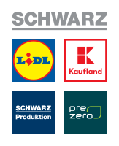




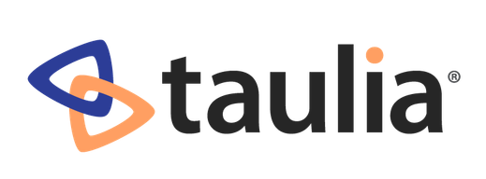




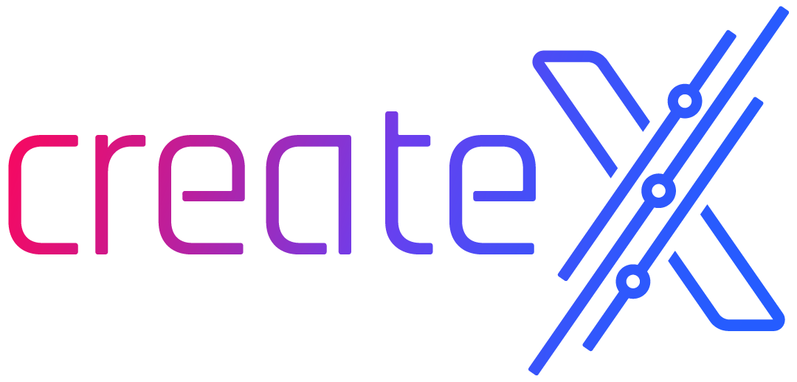
SoftUni Diamond Partners

Slide 46

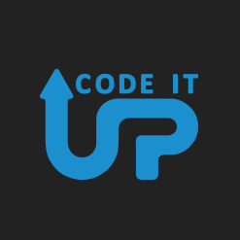
Educational Partners

Slide 47
Trainings @ Software University (SoftUni)
Software University – High-Quality Education, Profession and Job for Software Developers
softuni.bg, about.softuni.bg
Software University Foundation
softuni.foundation
Software University @ Facebook
facebook.com/SoftwareUniversity
Software University Forums
forum.softuni.bg
47
Notes:
47

Slide 48

License
This course (slides, examples, demos, exercises, homework, documents, videos and other assets) is copyrighted content
Unauthorized copy, reproduction or use is illegal
© SoftUni – https://about.softuni.bg
© Software University – https://softuni.bg
Notes:
48

